Slide 1
Mining Biomedical Data
Vipin Kumar
University of Minnesota
kumar@cs.umn.edu
www.cs.umn.edu/~kumar

Slide 2
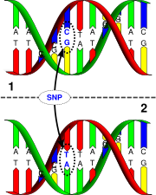
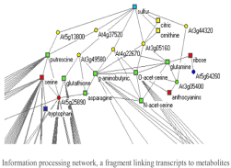

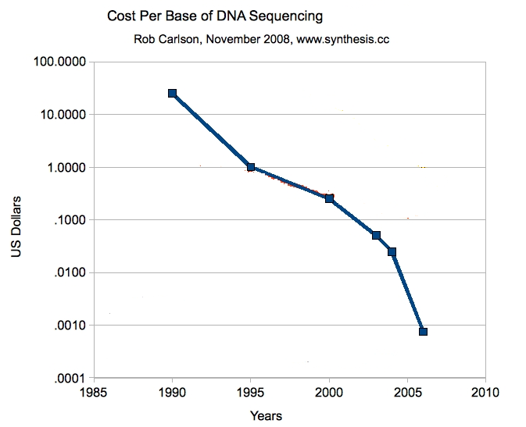
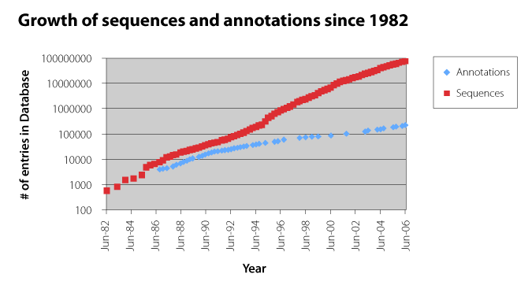
Mining Biomedical Data
Recent technological advances are helping to generate large amounts of clinical and genomic data
    Biological data sets
      Gene & protein sequences; Microarray data;
      Single Nucleotides Polymorphisms (SNPs);
      Biological networks; Proteomic data; Metabolomics data
    Electronic Medical Records (EMRs)
      IBM-Mayo partnership has created a DB of over 6 million patients
Data mining offers potential solution for analysis of this large-scale biomedical data
  Novel associations between genotypes and phenotypes
  Biomarker discovery for complex diseases
  Prediction of the functions of anonymous genes
  Personalized Medicine – Automated analysis of patients history for customized treatment
SNP
PPI Data
Gene Expression Data
Cost of sequencing has reduced dramatically
Source: www.synthesis.cc
Increasing gap between genome sequences and functional annotations [Meyers August 2006]

Slide 3
Challenges in Analyzing Biomedical Data
High dimensionality in the number of attributes (genes, SNPs) and relatively low sample size
  Difficult to find statistically significant results
    e.g., associations between gene(s) and disease phenotype
Heterogeneous data
  Structured and unstructured data elements, different types of data attributes
    e.g, gene expression data, networks and pathways, lab tests and pathology reports
Data is noisy, error-prone and has missing values
  Difficult to discover true structure due to poor data quality
Different biological data types provide complimentary but limited information
  Need to develop approaches that integrates multiple data sets

Slide 4
Case studies
Discovering novel associations among SNPs and disease phenotypes
  Addressing issue of high dimensionality
Subspace differential co-expression analysis for discovering disease subtypes
  Addressing the issue of high dimensionality and genetic heterogeneity

Slide 5
Application : SNP Association Study
Given: A patient data set that has genetic variations (SNPs) and their associated Phenotype (Disease).
Objective: Finding a combination of genetic characteristics that best defines the phenotype under study.
 | SNP₁ | SNP₂ | … | SNP_{M} | Disease
Patient ₁ | 1 | 1 | … | 1 | 1
Patient ₂ | 0 | 1 | … | 1 | 1
Patient ₃ | 1 | 0 | … | 0 | 0
… | … | … | … | … | …
Patient _{N} | 1 | 1 |  | 1 | 1
Genetic Variation in Patients (SNPs) as Binary Matrix and Survival/Disease (Yes/No) as Class Label.
Genetic Variation in Patients (SNPs) as Binary Matrix and Survival/Disease (Yes/No) as Class Label.
Genetic Variation in Patients (SNPs) as Binary Matrix and Survival/Disease (Yes/No) as Class Label.

Slide 6
SNP (Single nucleotide polymorphism)
Definition of SNP (wikipedia)
  A SNP is defined as a single base change in a DNA sequence that occurs in a significant proportion (more than 1 percent) of a large population
  How many SNPs in Human genome?
  10,000,000
Individual 1 A G C G T G A T C G A G G C T A
Individual 2 A G C G T G A T C G A G G C T A
Individual 3 A G C G T G A G C G A G G C T A
Individual 4 A G C G T G A T C G A G G C T A
Individual 5 A G C G T G A T C G A G G C T A
Each SNP has 3 values
( GG / GT / TT )
( mm / Mm/ MM)
SNP

Slide 7
Why is SNPs interesting?
In human beings, 99.9 percent bases are same.
Remaining 0.1 percent makes a person unique.
  Different attributes / characteristics / traits
    how a person looks,
    diseases a person develops.
These variations can be:
  Harmless (change in phenotype)
  Harmful (diabetes, cancer, heart disease, Huntington's disease, and hemophilia )
  Latent (variations found in coding and regulatory regions, are not harmful on their own, and the change in each gene only becomes apparent under certain conditions e.g. susceptibility to lung cancer)

Slide 8
Issues in SNP Association Study
In disease association studies number of SNPs varies from a small number (targeted study) to a million (GWA Studies)
Number of samples is usually small
Data sets may have noise or missing values.
Phenotype definition is not trivial (ex. definition of survival)
Environmental exposure, food habits etc adds more variability even among individuals defined under the same phenotype
Genetic heterogeneity among individuals for the same phenotype

Slide 9
Existing Analysis Methods
Univariate Analysis: single SNP tested against the phenotype for correlaton and ranked.
  Feasible but doesn’t capture the existing true combinations.
Multivariate Analysis: groups of SNPs of size two or more are tested for possible association with the phenotype.
  Infeasible but captures any true combinations.
These two approaches are used to identify biomarkers.
Some approaches employ classification methods like SVMs to classify cases and controls.

Slide 10
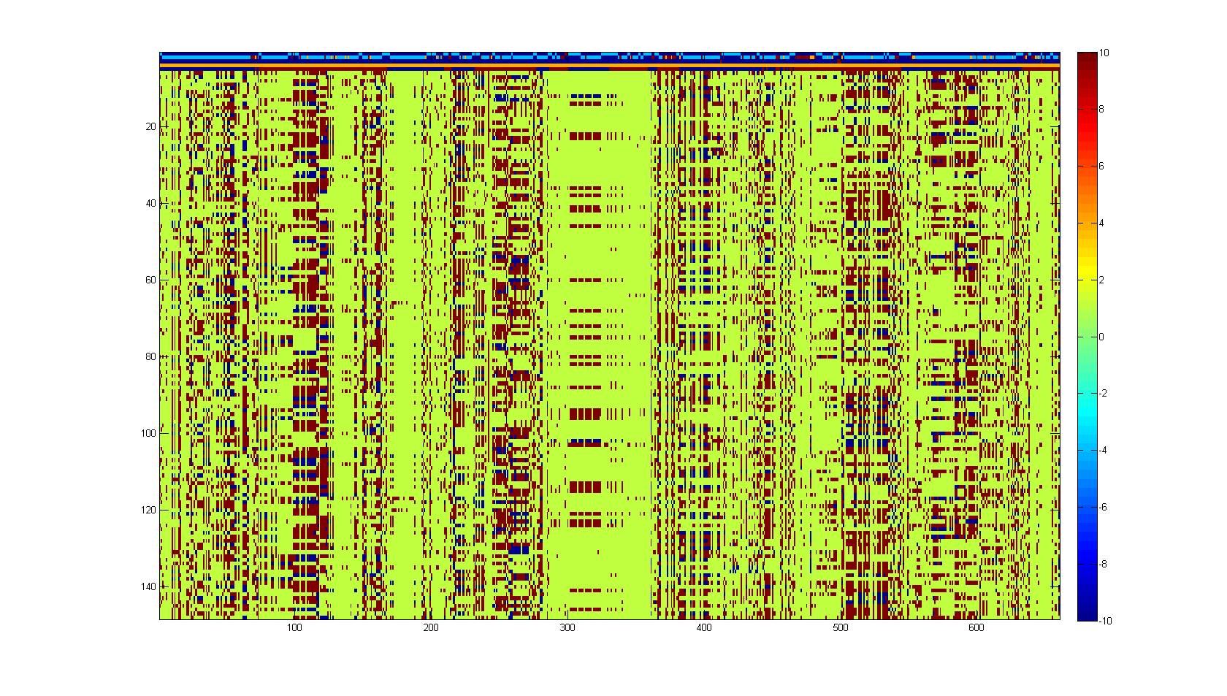
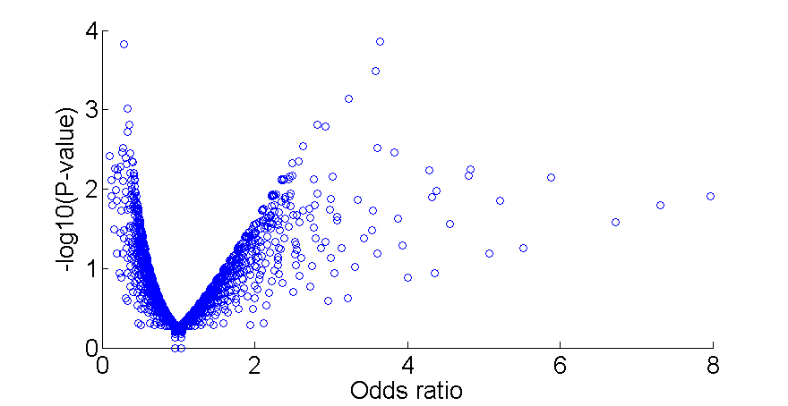
Case Study 1:
Discovering SNP Biomarkers
Given a SNP data set of Myeloma patients, find a combination of SNPs that best predicts survival.
3404 SNPs
3404 SNPs selected from various regions of the chromosome
70 cases (Patients survived shorter than 1 year)
73 Controls (Patients survived longer than 3 years)
cases
Controls
Complexity of the Problem:
Large number of SNPs (over a million in GWA studies) and small sample size
Complex interaction among genes may be responsible for the phenotype
Genetic heterogeneity among individuals sharing the same phenotype (due to environmental exposure, food habits, etc) adds more variability
Complex phenotype definition (eg. survival)
Highest p-value, moderate odds ratio
Highest odds ratio, moderate p value
Moderate odds ratio, moderate p value

Slide 11
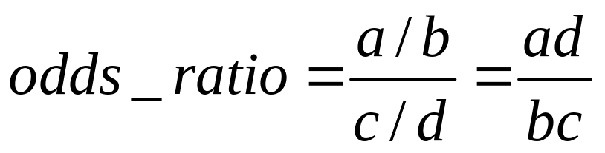
Odds ratio
Odds ratio is defined as the following
Measures whether two groups have the same odds of an event.
Log odds ratio is often used
Odds ratio is invariant to row and column scaling
 | Biomarker (SNPs)
CLASS |  | Has Marker | Lacks Marker
 | CASE | a | b
 | Control | c | d
OR = 1 | Odds of event is equal in both groups
OR > 1 | Odds of event is higher in cases
OR < 1 | Odds of event is higher in controls

Slide 12
P-value
P-value
  Statistical terminology for a probability value
  Is the probability that the we get an odds ratio as extreme as the one we got by random chance
  Computed by using the chi-square statistic or Fisher’s exact test
    Chi-square statistic is not valid if the number of entries in a cell of the contingency table is small
    p-value = 1 – hygecdf( a – 1, a+b+c+d, a+c, a+b ) if we are testing value is higher than expected by random chance using Fisher’s exact test
      A statistical test to determine if there are nonrandom associations between two categorical variables.
  P-values are often expressed in terms of the negative log of p-value, e.g., -log10(0.005) = 2.3

Slide 13
Example: High pvalue, moderate odds ratio
 | Biomarker (SNPs)
CLASS |  | Has Marker | Lacks Marker
 | CASE | (a) 40 | (b) 30
 | Control | (c) 19 | (d) 54
Odds ratio = (a*d)/(b*c) = (40 * 54) / (30 * 19) = 3.64
P-value = 1 – hygecdf( a – 1, a+b+c+d, a+c, a+b )
= 1 – hygecdf( 39, 143, 59, 70 )
log10(0.0243) = 3.85

Slide 14
Example …
 | Biomarker (SNPs)
CLASS |  | Has Marker | Lacks Marker
 | CASE | (a) 7 | (b) 63
 | Control | (c) 1 | (d) 72
Odds ratio = (a*d)/(b*c) = (7 * 72) / (63* 1) = 8
P-value = 1 – hygecdf( a – 1, a+b+c+d, a+c, a+b )
= 1 – hygecdf( 6, 143, 8, 70)
log10(pvalue) = 1.91

Slide 15
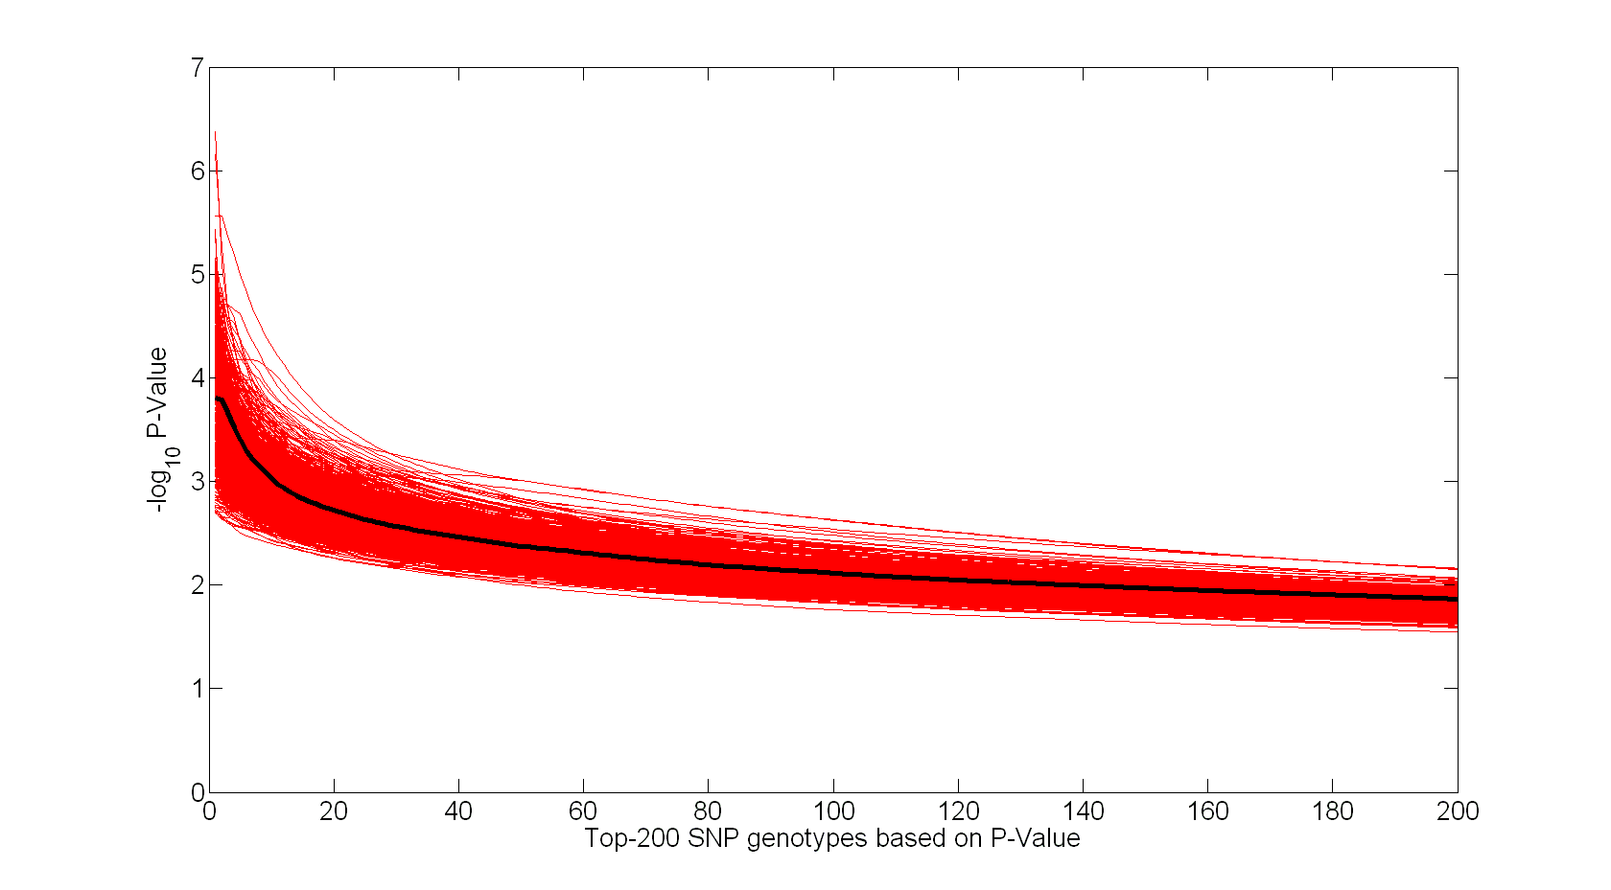
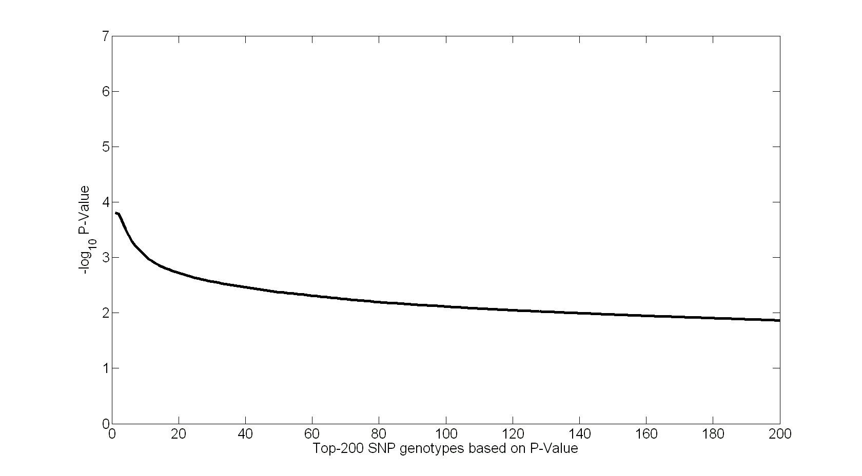

Case Study 1:
Issues with Traditional Methods
Each SNP is tested and ranked individually
Individual SNP associations with true phenotype are not distinguishable from random permutation of phenotype
Top ranked SNP:
-log₁₀P-value = 3.8; Odds Ratio = 3.7
Van Ness et al 2009
However, most reported associations are not robust: of the 166 putative associations which have been studied three or more times, only 6 have been consistently replicated.

Slide 16
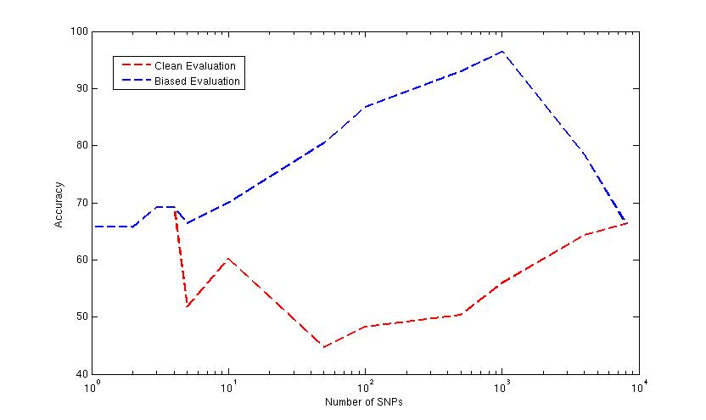
Evaluating the Utility of Univariate Rankings for Myeloma Data
Leave-one-out
Cross validation
With SVM
Leave-one-out Cross
validation with SVM
Feature
Selection
Feature Selection
Biased Evaluation
Clean Evaluation

Slide 17
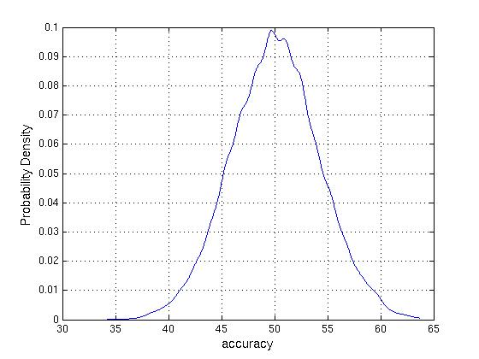
Random Permutation test
10,000 random permutations of real phenotype generated.
For each one, Leave-one-out cross validation using SVM.
Accuracy larger than 65% are highly significant. (p-value is < 10⁻⁴)

Slide 18
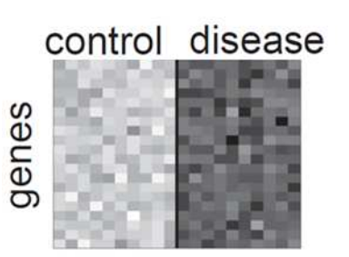
Case Study 2:
Differential expression ➔ Differential coexpression
Differential Expression (DE)
  Traditional analysis targets the changes of expression level
controls
cases
Expression level
Expression over samples in controls and cases
[Golub et al., 1999], [Pan 2002], [Cui and Churchill, 2003] etc.

Slide 19
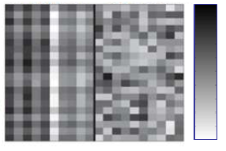
Differential Coexpression (DC)
Differential Coexpression (DC)
  Targets changes of the coherence of expression
controls
cases
controls
cases
Question: Is this gene interesting, i.e. associated w/ the phenotype?
Answer: No, in term of differential expression (DE).
However, what if there are another two genes ……?
genes
Matrix of expression values
Yes!
Expression over samples in controls and cases
[Kostka & Spang, 2005]
Biological interpretations of DC: Dysregulation of pathways, mutation of transcriptional factors, etc.
[Silva et al., 1995], [Li, 2002], [Kostka & Spang, 2005], [Rosemary et al., 2008], [Cho et al. 2009] etc.

Slide 20
Differential Coexpression (DC)
Existing work on differential coexpression
  Pairs of genes with differential coexpression
    [Silva et al., 1995], [Li, 2002], [Li et al., 2003], [Lai et al. 2004]
  Clustering based differential coexpression analysis
    [Ihmels et al., 2005], [Watson., 2006]
  Network based analysis of differential coexpression
    [Zhang and Horvath, 2005], [Choi et al., 2005], [Gargalovic et al. 2006], [Oldham et al. 2006], [Fuller et al., 2007], [Xu et al., 2008]
  Beyond pair-wise (size-k) differential coexpression
    [Kostka and Spang., 2004], [Prieto et al., 2006]
  Gene-pathway differential coexpression
    [Rosemary et al., 2008]
  Pathway-pathway differential coexpression
    [Cho et al., 2009]

Slide 21
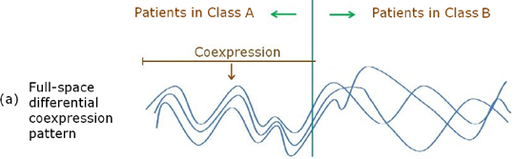
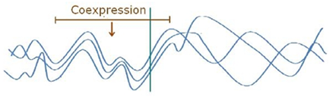
Existing DC work is “full-space”
Full-space differential coexpression
May have limitations due to the heterogeneity of
  Causes of a disease (e.g. genetic difference)
  Populations affected (e.g. demographic difference)
Full-space measures: e.g. correlation difference
Motivation:
Such subspace patterns may be missed by full-space models

Slide 22


Extension to Subspace Differential Coexpression
Definition of Subspace Differential Coexpression Pattern
  A set of k genes = {g1, g2 ,…, gk}
  : Fraction of samples in class A, on which the k genes are coexpressed
  : Fraction of samples in class B, on which the k genes are coexpressed
Problem: given n genes, find all the subsets of genes, s.t. SDC≥d
as a measure of subspace differential coexpression
Details in [Fang, Kuang, Pandey, Steinbach, Myers and Kumar, PSB 2010]

Slide 23

Computational Challenge
Problem: given n genes, find all the subsets of genes, s.t. SDC≥d
Given n genes, there are 2^{n} candidates of SDC pattern!
How to effectively handle the combinatorial search space?
Similar motivation and challenge as biclustering, but here
differential biclustering !

Slide 24
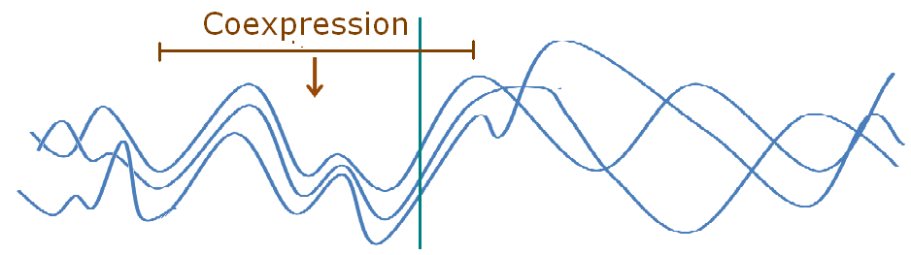

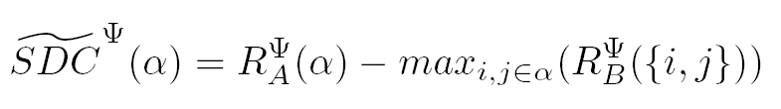
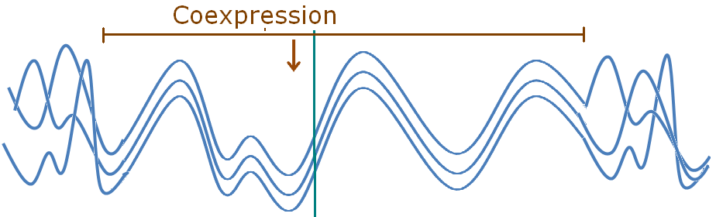


Direct Mining of Differential Patterns
Refined SDC measure: “direct”
>>
A measure M is antimonotonic if V A,B: A B ➔ M(A) >= M(B)
≈
Details in [Fang, Kuang, Pandey, Steinbach, Myers and Kumar, PSB 2010]
[Fang, Pandey, Gupta, Steinbach and Kumar, IEEE TKDE 2011]

Slide 25

An Association-analysis Approach
Refined SDC measure
Disqualified
A measure M is antimonotonic if V A,B: A B ➔ M(A) >= M(B)
Advantages: 1) Systematic & direct 2) Completeness 3) Efficiency
Prune all the supersets
[ Agrawal et al. 1994]

Slide 26
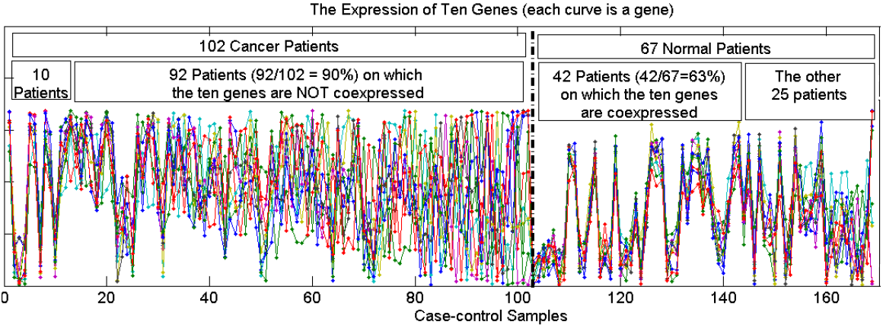
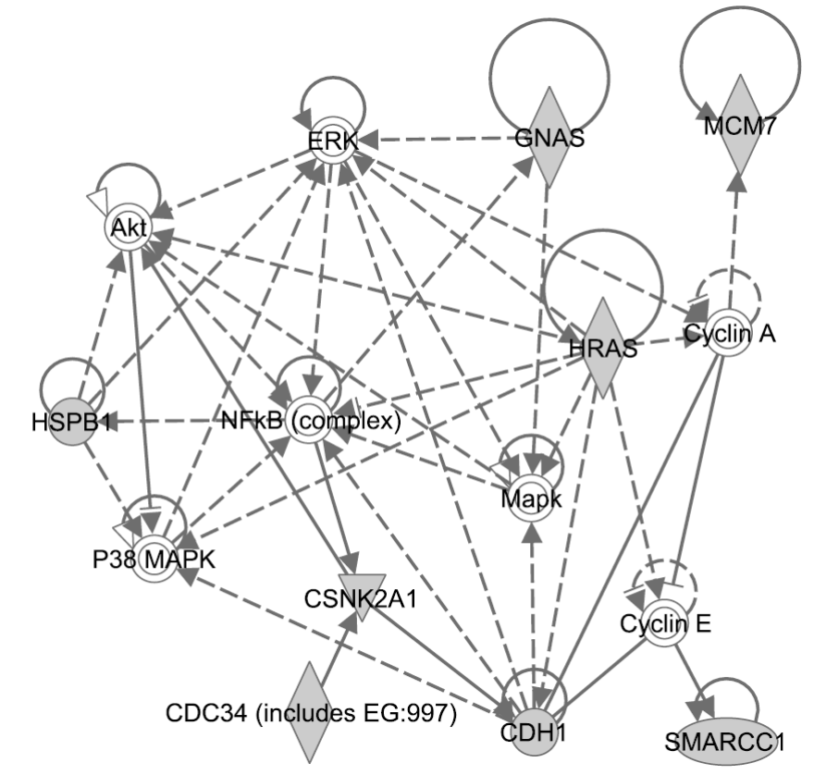
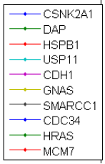
A 10-gene Subspace DC Pattern
Enriched with the TNF-α/NFkB signaling pathway (6/10 overlap with the pathway, P-value: 1.4*10⁻⁵)
Suggests that the dysregulation of TNF-α/NFkB pathway may be related to lung cancer
≈ 10%
≈ 60%
www. ingenuity.com: enriched Ingenuity subnetwork

